Slide 1
dextermiller.com
Dexter Miller
B.S. Computer Science
Minor in Mathematics
Indiana Tech College of Engineering & Computer Sciences
Notes:
Hello! Thank you for joining me for my presentation. my name is Dexter Miller my degree is in Computer Science with a Minor in mathematics from Indiana Tech, and this is my senior project!

Slide 2


Project Statement
This project is an implementation of an AI for Tic-Tac-Toe and Connect 4. The project is presented via my website – dextermiller.com – which is a separate part of the project.
Notes:
This project is an implementation of an AI for Tic-Tac-Toe and Connect 4. The project is presented via my website – dextermiller.com – which is a separate part of the project.
The main focus of this project is the AI and how I implemented it for Tic-Tac-Toe and connect 4. However, there is the part of the project where I built my website, but the main focus is the AI implementation for the games.
Normally, you would be able to see me when I present, so just in case you were wondering what I look like, here is an image.

Slide 3
Overview
Design and Implementation of my website increased knowledge of:
Application of programming skills to different languages
C++ -> JS
Artificial intelligence (AI)
Analysis of AI
Tic-tac-toe
Connect 4
Website requirements:
Ubuntu Server (hosting)
Domains (google sites)
Notes:
To explain where I got the idea for my senior project it started. In my Sophomore year of college I programmed Tic-tac-toe and Connect 4 with an ASCII output. I wanted to build upon it and allow for an AI feature to play against. To do this I had to start over and build the games in JavaScript.
To build the AI I found the Minimax algorithm and it’s applications for strategic base games. It is important to note that this algorithm only works in purely strategic games, or games that don’t involve chance, like Yahtzee. Analyzing the different types of AI it was clear to see that this is perfect algorithm for Tic-tac-toe and Connect 4.
To build my web server, From my employment I came across a scrap computer that I wanted to tinker with, so after getting permission, I decided to turn it into an Ubuntu Server. I simply installed Ubuntu Server 18.04 OS on my scrap computer which acts as an apache server. Rather than simply accessing my server via public ip, I purchased the domain from google domains, and forward the ip to the domain using Google's domain servers. Fortunately, no one else with the name dextermiller decided to make a website and use that domain. So this was the start of building my website, along with the help of an HTML editor Mobirise.

Slide 4
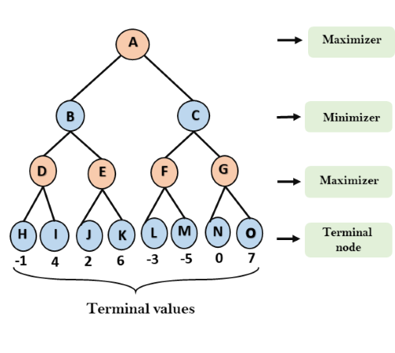
Analysis & Design
Algorithms
Minimax
Alpha-Beta
Terminal States
If win
Max: 10-depth
Min: -10+depth
Draw: 0
Notes:
Moving onto Analysis & Design; I used two different but very similar Algorithms, Minimax and Alpha-Beta pruning. Both of these algorithms are recursive with two players returning it’s best move to the parent node. Generally, in a game there are two players, where each is trying to better its position. Lets call the two players Min and Max, hence the name.
The Max player is always trying to pick the highest score, whereas the Min does the opposite. Naturally we would assume our opponent is going to make the best move for themselves, so that is what is simulated. In this recursive algorithm there are terminal states that we need to evaluate to return up the tree, I’ll explain how this works in the next slide.
To understand how I scored a terminal node in Tic-Tac-Toe, first you need to know what the depth is. The depth is the distance from the root of the tree to the desired node.
To score the terminal node, I took the depth and add it or subtract it to the winner’s score, depending if the node was a maximizer or minimizer. This is because I want to score a move better if it has a lesser depth. Later I’ll explain how I scored the Connect 4 terminal states.

Slide 5
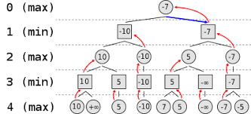
Minimax Algorithm
Notes:
This is an illustration on how the terminal states are passed up from max to min. It is important to note that the min is always choosing the lesser of It’s leaf values, and max is choosing the greater. At first I thought of this algorithm as me playing against an opponent where I’m always trying to improve my score, in the positive direction, and my opponent improves their score in the negative direction.
You can see at each minimizer node and each maximizer node, they pick the corresponding value that suits their name.

Slide 6
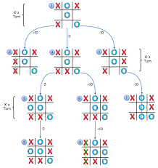
Minimax cont.
Notes:
Now that you know how the scoring works, This image shows how the branching works. Rather than just having two child nodes, a board branches out based on each available spot. In my Tic-Tac-Toe game this is done until the board is full or there is a win. Then, as you can see, the score is returned up through the tree (show on board)
so the maximum player, at the root, can make a decision on the best path to take.

Slide 7
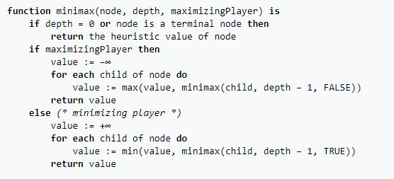
Minimax Pseudocode
Notes:
To implement the trees I’ve been showing you, This pseudocode describes it pretty well. First, It checks for a terminal node. If there is no terminal node, then it is either the maximizer’s turn or the minimizers. On the player’s turn, we want to simulate a move, get the value of that move, and call the minimax function with the placed move to return a value of that child node. This pseudocode mentions depth, which I did not use in my implementation for tic-tac-toe. My version continued until it reached the state of a win or draw.

Slide 8
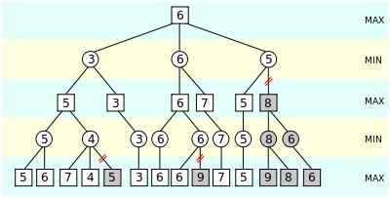
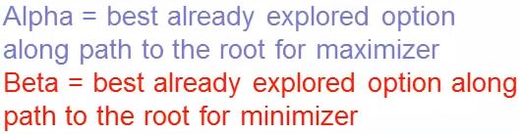
Alpha-Beta Pruning
Notes:
Now that you know how the minimax works, alpha-beta pruning is a way to improve upon the original minimax algorithm. Alpha is defined as the best (highest-value) choice we have found so far along the path to the root for the maximizer. The initial value of alpha is –Infinity. Beta is the best (lowest-value) choice we have found so far along the path to the root for the minimizer. The initial value of beta is Infinity.
To understand how the pruning works you need to keep track of alpha and beta. Remember, the MAX (or maximizer) only updates alpha, where the MIN (or minimizer) only updates beta. Think of these two as variables that we update as we search through the tree. At the root alpha and beta are initialized to +/- infinity. Let me do a quick walk through.
Because Alpha >= Beta, we don’t search…

Slide 9
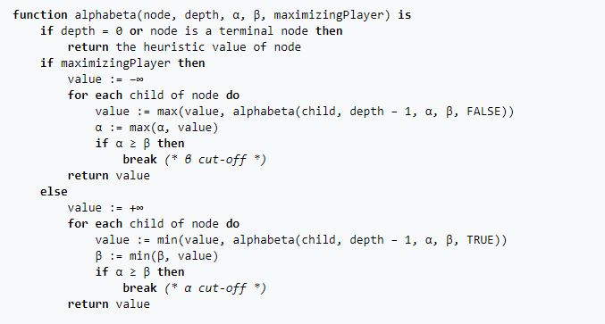
Alpha-Beta pseudocode
Notes:
As you can see, this is very similar to the Minimax pseudocode, but there is a break in the for loop, which iterates through each value. The reason the break is in there, is because this skips over unnecessary searches, and breaks out of the for loop.

Slide 10
Connect 4 Scoring
Win in all directions += 100
Horizontal
Vertical
Diagonals
3 in a row += 5
2 in a row += 2
Opponent 3 in a row -= 5
Center Column scoring += center count * 3
Notes:
The scoring function is a critical part of making the minimax/alpha-beta algorithm work. The first thing that needs to happen is for the AI to make a winning move in all directions: horizontal, vertical, and diagonals. I set the score for these positions to 100.
But, not every move is going to be a winning move, so we need to score 3 and 2 in a row. I set these to add 5 and 2 to the score.
I also need to score an opponent, because we need to block an opponent if they have 3 in a row. Therefore set this to add -5 to the score.
Lastly, I needed to score the center column, because it allows for the most options with diagonals, horizontals, and options to win. To do this I created a counter for the number of player pieces in the center column. Then I score that position by multiplying the center count by 3 and adding it to the score position.
I know this isn’t the most optimal way to score the connect 4 board, but it was what got me started and helped me move forward with this project.

Slide 11
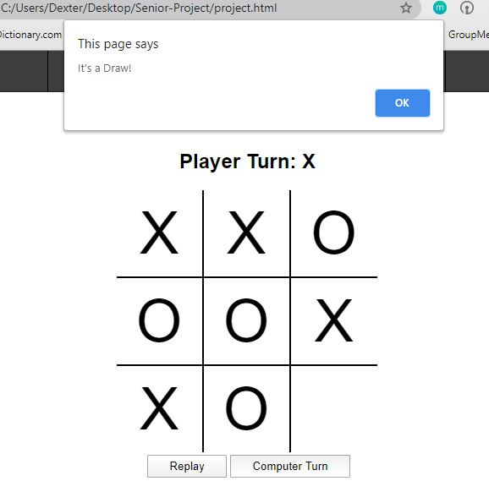
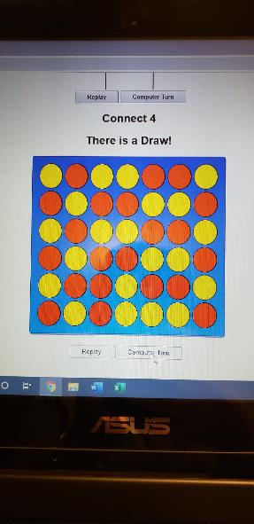
Testing
Playing the game!
Alert Function
Tic-Tac-Toe is essentially unbeatable
The connect 4 is hard
Notes:
I’ve had lot’s of friends and family play against my AI and interact with my website. The feed back I received was great! From spelling mistakes to the user interface of the games.
For example, the image shown on the right is a good example of an issue others pointed out to me. When the last move was played, the script wouldn’t fill the HTML element before showing the alert. After fixing that issue, Tic-Tac-Toe seemed to work pretty well … and unbeatable.
However, the Connect 4 AI is difficult to beat, but it’s not impossible. I’ve played my AI against a connect 4 solver I found online, and it lost! The connect 4 AI is set to a depth of 6. So it’s not impossible to beat, but can be pretty hard against a human player. That being said, the picture shown to the left is the result of my dad forcing a draw against the computer, which I thought was pretty cool!

Slide 12
Tic-Tac-Toe Data
Tic-Tac-Toe (Minimax)
Moves on board | Iterations | Average Time (ms)
1 | 549,946 | 211.77
2 | 59,705 | 22.58
3 | 7332 | 2.69
4 | 935 | 0.36
5 | 198 | 0.10
6 | 47 | 0.13
7 | 14 | 0.02
8 | 5 | 0.01
9 | 2 | 0.008
Notes:
To understand the data I'm going to show you, you need to understand what I gathered. I ran the computer turn function to play 9 moves on the board for Tic-Tac-Toe, with each turn the function returned the number of iterations along with the time, which is in milliseconds, to make the move. I did a set of 9 moves on the board 5 times; Then I took the average times seeing as they varied.
As the board starts to get filled it is clear to see that the number of iterations decrease exponentially as well as the time to run the minimax function. Because I didn’t set a depth limit nor did I implement alpha-beta pruning on the Tic-Tac-Toe implementation, we can expect the exponential decrease shown in the graph.

Slide 13
Connect 4 Data
Connect 4 (Minimax)
Moves | Iterations | Average Time (ms)
1 | 137257 | 981.15
2 | 137256 | 869.09
3 | 135743 | 853.90
4 | 137218 | 859.41
5 | 135669 | 896.13
6 | 134385 | 848.86
7 | 130637 | 851.21
8 | 131334 | 851.87
9 | 125387 | 840.05
Averages | 133876.20 | 872.41
Connect 4 (Alpha-Beta)
Moves | Iterations | Average Time (ms)
1 | 9007 | 150.18
2 | 12769 | 99.24
3 | 7628 | 57.44
4 | 9415 | 54.16
5 | 9065 | 75.85
6 | 7585 | 43.80
7 | 8542 | 48.43
8 | 8246 | 48.70
9 | 9214 | 54.55
Average | 9052.33 | 70.26
Notes:
Similar to the previous slide, I performed the same process gathering the averages of iterations and time in milliseconds.
However; I did set the depth limit to 6 in this implementation of Connect 4. Since the game isn’t over in 9 moves, we don’t see an exponential decrease. Rather, we do see a significant difference between the minimax algorithm and alpha-beta pruning.
The difference I found in iterations from the Minimax to the alpha-beta pruning is a 93.24% decrease in iterations and the average time decreased 91.95%! It is clear to see that Alpha-beta pruning is much more efficient than minimax.

Slide 14
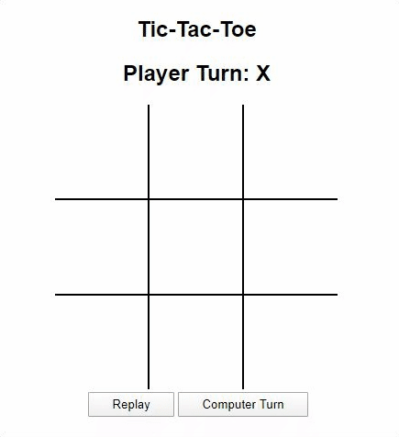
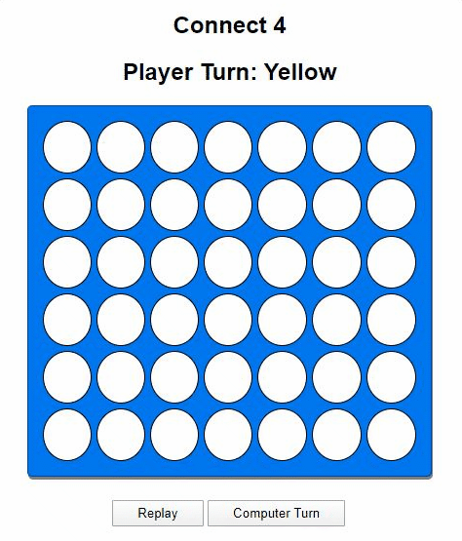
Demonstration
dextermiller.com
Notes:
Its nothing too fancy, but it’s what the games look like on my website. If you haven’t visited dextermiller.com yet, this is how it works.
You can play the game by simply clicking on the column or square you’d like or you can select the computer turn for the AI to make a turn.
As I mentioned earlier, the website was a separate part of my project, but I wanted to focus on the implementation of the AI. The “about me” page was my attempt to create a professional website along with personal merchandise in “products” and more information on the project under “information”.

Slide 15
Summary
Challenges
Thinking recursively
Mitigation/solution
Research
Future?
Difficulty
More Games!
Notes:
Looking back on this project there were several challenges I had to over come. There were a lot of check win functions I had to figure out, and checking the algorithm to make sure worked correctly.
I’ve always struggled to think recursively. These algorithms weren’t easy for me to wrap my mind around, but once I shown some grit and figured it out, it was worth it.
Formatting the boards in CSS presented a challenge, but once I figured out tic-tac-toe, the connect 4 was easier to put together, since I had a background with the tic-tac toe.
Solution:
The solution to these challenges was simply talking it out. Whether that be to a friend or even a wall. I did a lot of research on syntax, algorithm implementation, and basic web development. There are a lot of resources on the internet and that’s what I used.
For the Future:
I want to add a depth changer to Connect 4. I know the depth is set to 6 right now, but I want people to be able to change the difficulty and play with the depth at different levels, and have a fighting chance against the AI.
I also want to add more games in the future. I don’t want to stop with just the games from sophomore year. I want to look into a game that will require a different type of AI.
So those are some ideas I have for my website and the things to come!

Slide 16
Citations
“Artificial Intelligence: Alpha-Beta Pruning - Javatpoint.” www.javatpoint.com, JavaTpoint, www.javatpoint.com/ai-alpha-beta-pruning.
“Minimax.” Wikipedia, Wikimedia Foundation, 17 Apr. 2020, en.wikipedia.org/wiki/Minimax.
Vandewiele, Gilles. “Creating the (Nearly) Perfect Connect-Four Bot with Limited Move Time and File Size.” Medium, Towards Data Science, 7 Jan. 2019, towardsdatascience.com/creating-the-perfect-connect-four-ai-bot-c165115557b0.
“On-Demand Print & Embroidery Fulfillment and Warehousing Services.” Printful, www.printful.com.
“Welcome to Shopify.” Welcome to Shopify, accounts.shopify.com/.
“Find Your Place Online.” Google Domains | Register Your Domain Name – Google Domains, Google, domains.google.com/.
Notes:
“Artificial Intelligence: Alpha-Beta Pruning - Javatpoint.” www.javatpoint.com, JavaTpoint, www.javatpoint.com/ai-alpha-beta-pruning.
“Minimax.” Wikipedia, Wikimedia Foundation, 17 Apr. 2020, en.wikipedia.org/wiki/Minimax.
Vandewiele, Gilles. “Creating the (Nearly) Perfect Connect-Four Bot with Limited Move Time and File Size.” Medium, Towards Data Science, 7 Jan. 2019, towardsdatascience.com/creating-the-perfect-connect-four-ai-bot-c165115557b0.
“On-Demand Print & Embroidery Fulfillment and Warehousing Services.” Printful, www.printful.com/.

Slide 17
Questions

